Slide 1
India Import Data Analysis
2025 – 2026 Latest Data

Slide 2
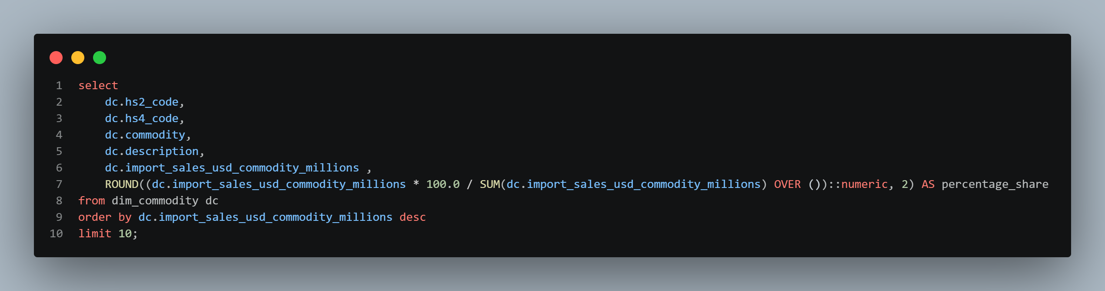
What are the top 10 import commodities (HS4) by value, and what share of total imports does each hold?

Slide 3
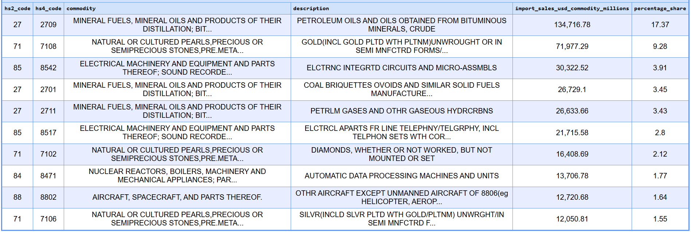
Result

